Slide 1

NATURAL RESOURCES
Presented by
UBNDPrasad
.

Slide 2

Natural Resources
Natural resources are things that are found in nature that are useful to people and animal.
Natural resources are of two types. They are
1.Non-Renewable resources
2.Renewable resources

Slide 3
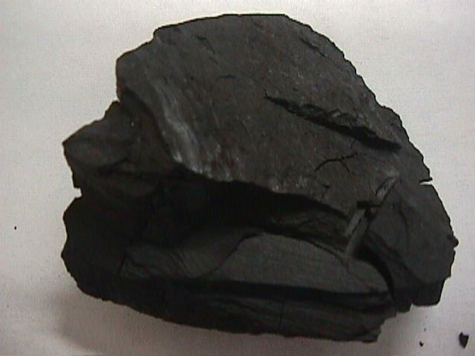
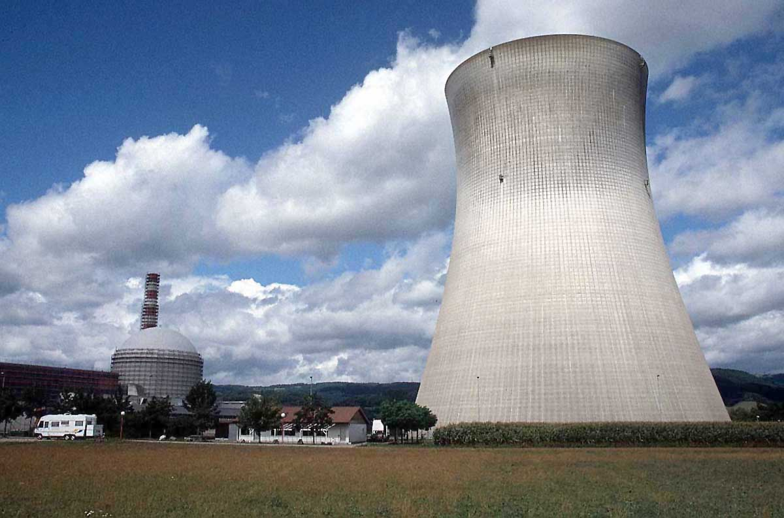
1.Non-renewable Resources
Those resources which cannot be replenished in a short period of time like minerals (coal, petroleum, natural gas, metals etc.)

Slide 4
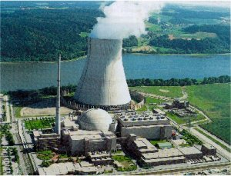
Nuclear Energy:
Nuclear fission uses uranium to create energy.
Nuclear energy is a non-renewable resource because once the uranium is used, it is gone!

Slide 5
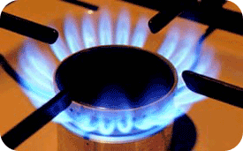

Coal, Petroleum And Gas:
Coal, petroleum, and natural gas are considered non-renewable because they can not be replenished in a short period of time. These are called fossil fuels.

Slide 6
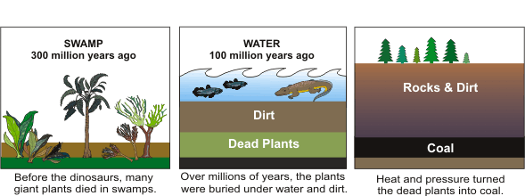
HOW IS COAL MADE ???

Slide 7
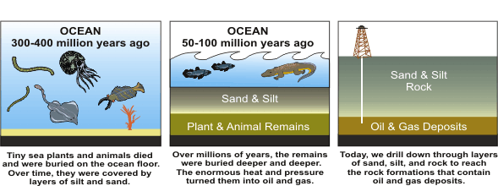
HOW ARE OIL AND GAS MADE ???

Slide 8
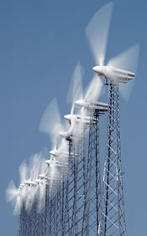
2.Renewable Resources
Renewable resources are natural resources that can be replenished in a short period of time.
● Solar
● Geothermal
● Wind
● Biomass
● Water

Slide 9

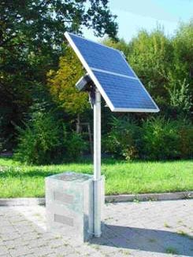
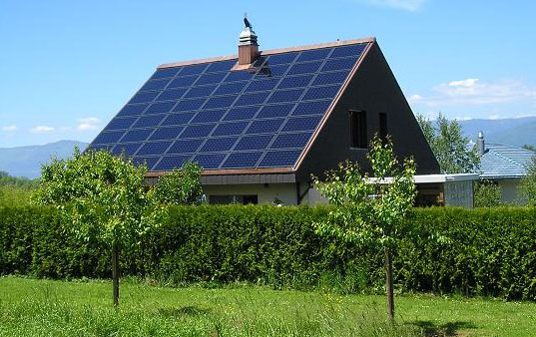
Solar Energy:
Solar energy is energy from the sun.
More and more, people are investing in solar panels on the roof of their home, whereby solar cells actively collect energy and transform it into electricity.

Slide 10
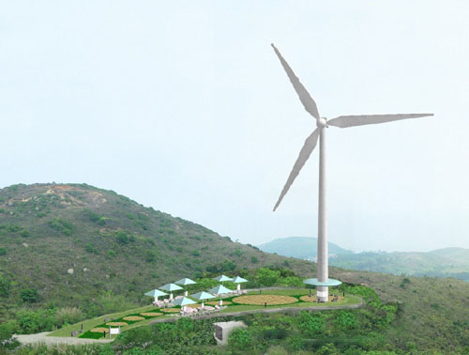
Wind Power:
Wind has been used from thousands of years as a source of energy on sailing ships and windmills to pump water.
Today, windmills can be used to generate electricity, usually located on a wind farm.

Slide 11
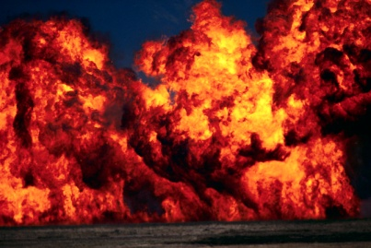
Biomass Energy:
which is energy derived from burning organic material like wood, alcohol, or garbage, is a common renewable energy resource.
A drawback of burning these items is that increasing air pollution.

Slide 12
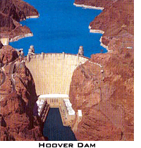
Water or Hydroelectric:
Hydroelectric energy is created releasing large amounts of water through a man-made dam, which turn turbines, or generators to create electricity.
Lake Murray Dam in Columbia is an example of a hydroelectric dam.

Slide 13
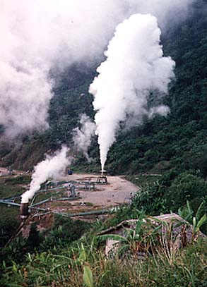
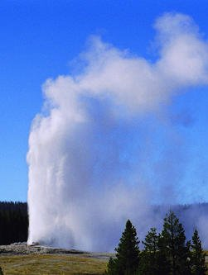
Geothermal Energy:
Large reservoirs within the ground contain heated water from internal heat in the earth. This heated water can create steam, thereby producing geothermal energy.
Only certain regions of the earth have these geothermal hotspots, such as Hawaii and Iceland. Yellowstone National Park would be a very good resource for geothermal energy.

Slide 14


The Three R’s to save the environment:

Slide 15

Questions…?

Slide 16
Thank
You……

